Slide 1
Design & Development of Video Watermarking
GROUP Number: 4
(BTECH CSE-2013)
GROUP MEMBER:
1.Himanshu soni
2.Sushil gupta
3.Ved Prakash
4.Ajit Singh Sisodiya
5.Gajanand bharti
Project Guide:
Mr. Mukesh azad
Project incharge:
Mr. shahjahan ali

Slide 2
Contents:
1.Introduction to Video Watermarking
2.Purpose
3.Target Audience
4.Use Case Diagram
5.Application(App)
6.Demo with Snapshot
7.Future Enhancement
8.Sample Code
9.Implementation
10.Benefits of Using Our Application
11.Project Limitation
12. Project Application and Conclusion
13.References

Slide 3
Introduction to Video Watermarking
Video watermarking involves embedding secret symbols known as watermarks within video data which can be used later for copyright detection and authentication verification purposes.

Slide 4
Purpose
Provide information.
Focuses on Protecting Video Copyright by:
Adding identity
Signature,
Ownership text,
Company logo ,
Geometry graphics on video files

Slide 5
Target Audience
For People Who Are:
YouTube users who upload original video files
Video website webmasters who offers different video files in public
Video studios that makes video tutorials only for education
Movie websites which need to protect original movie copyright
Family DV users who want to do some simple designs
All video recorders who want to protect their video copyright and do simple designs

Slide 6
Use Case Diagram
Video Watermarking
Other User
App User
Select Video
Select Image
Watermark Video
Explore Creation
Share on Social Site Page

Slide 7
Application(App)
-Application Category: Android based application.
-Database Requirement: No data base required.
-Internet connectivity: Required connectivity for fully functional app.
-Availability: Available easily on Play Store.
-Permission: Storage and Internet permission required

Slide 8
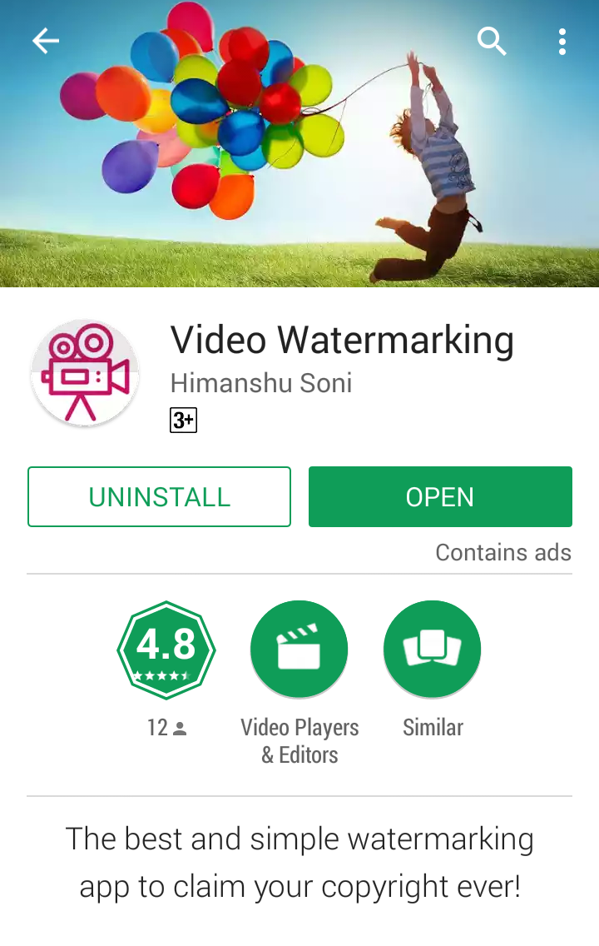
Demo with Snapshot
Preview of Module 1:
Download app from play store

Slide 9
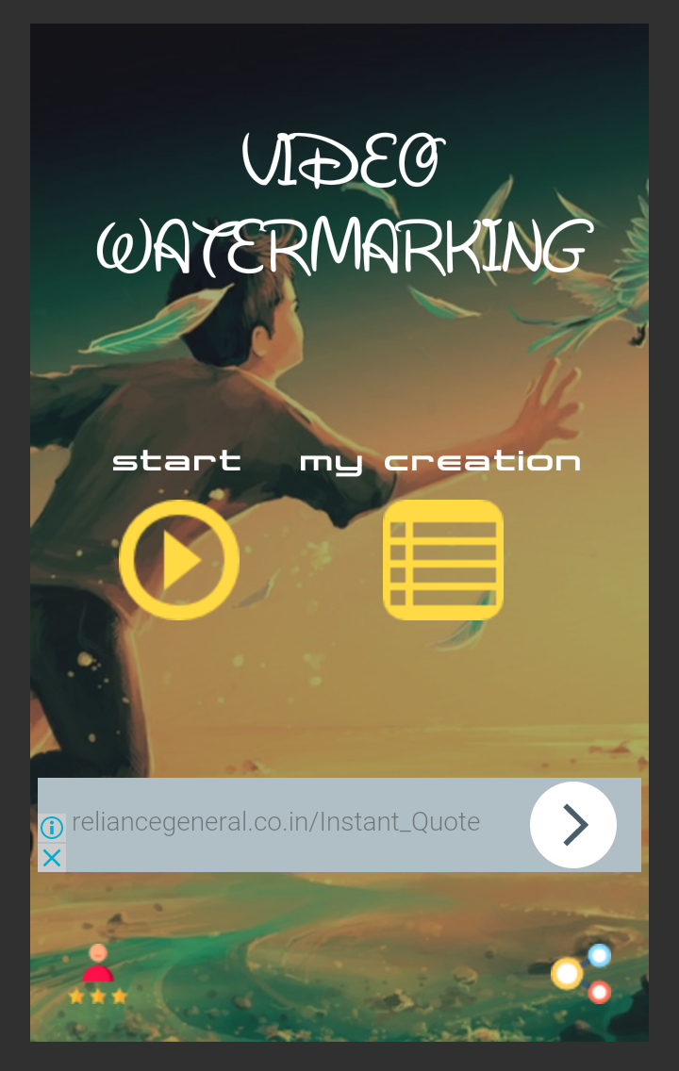
Demo with Snapshot
Preview of Module 2:
Welcome to Home Screen

Slide 10
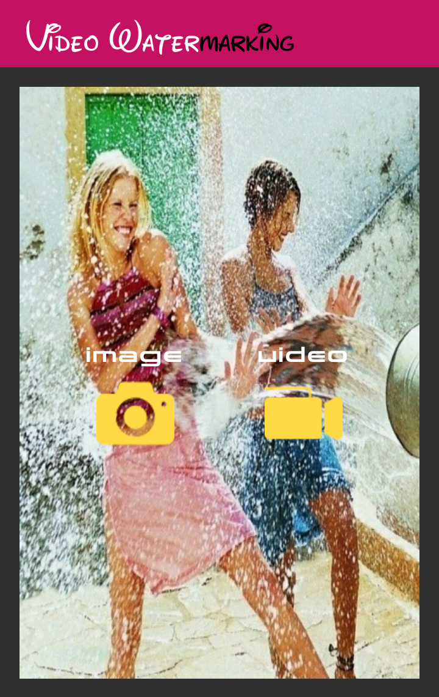
Demo with Snapshot
Preview of Module 3:
Select Your Media Content Here

Slide 11
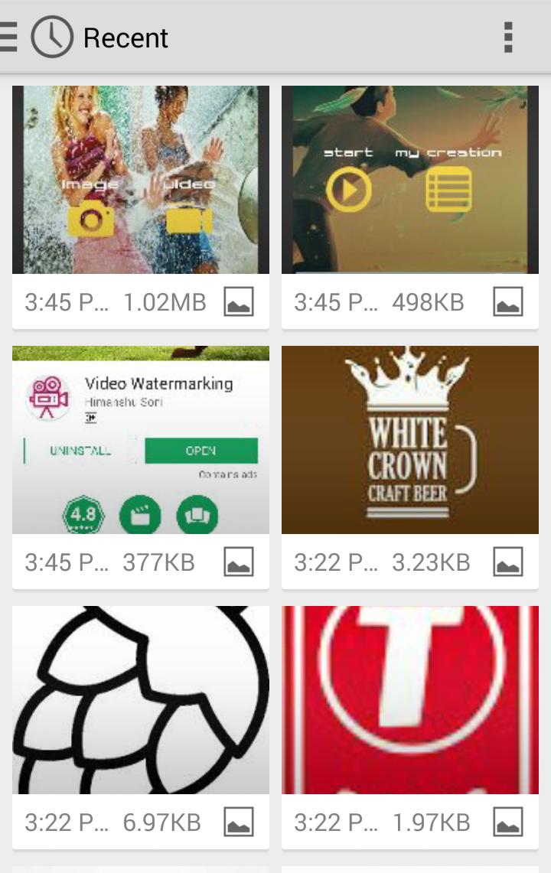
Demo with Snapshot
Preview of Sub Module 3.1:
Pick any logo to display on Video

Slide 12
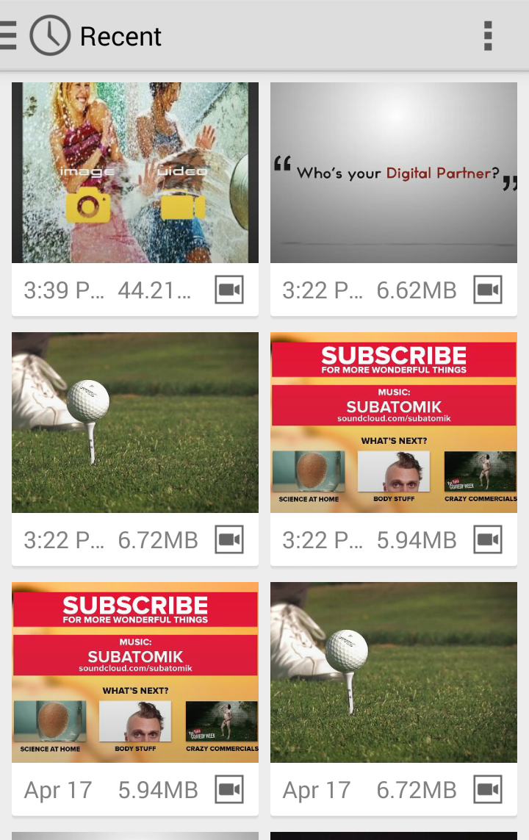
Demo with Snapshot
Preview of Sub Module 3.2:
Pick any video to have watermark of logo

Slide 13
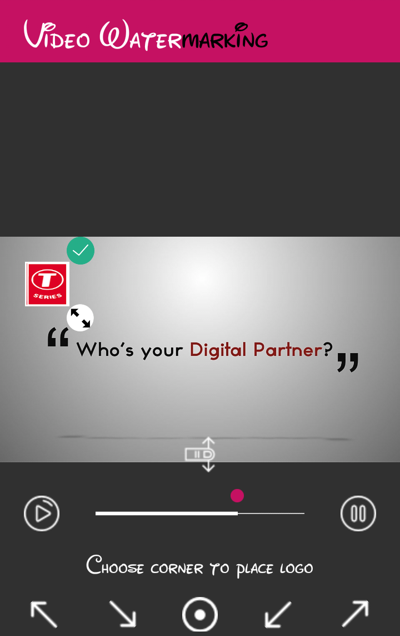
Demo with Snapshot
Preview of Module 4:
Customization Screen

Slide 14
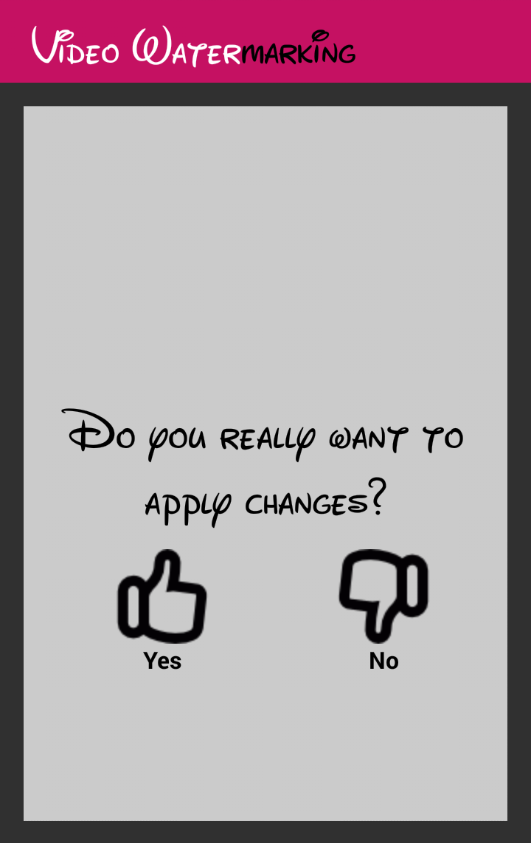
Demo with Snapshot
Preview of Module 5:
Apply changes

Slide 15
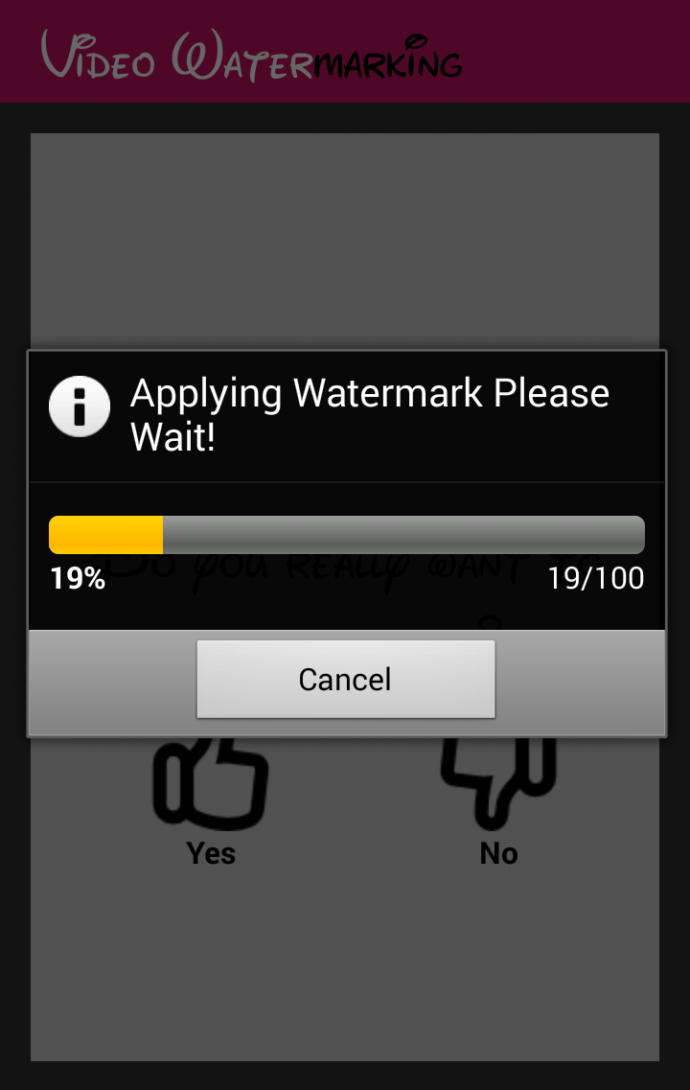
Demo with Snapshot
Preview of Sub Module 5.1:
Applying changes

Slide 16
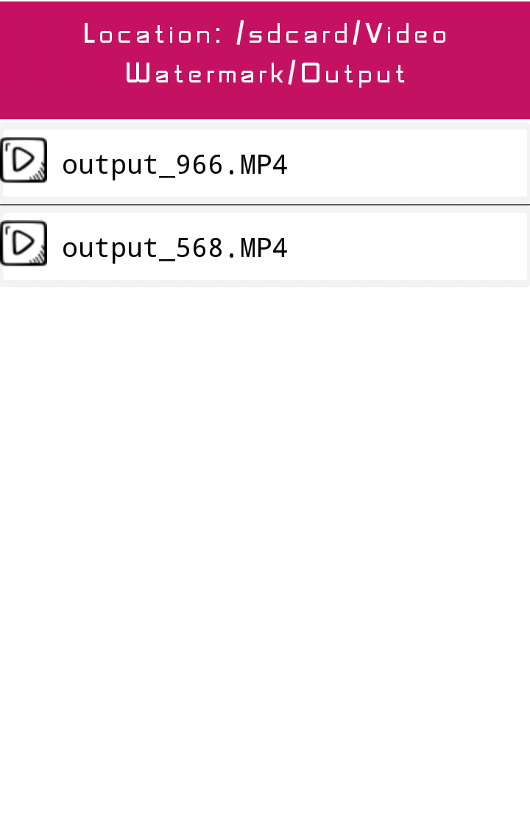
Demo with Snapshot
Preview of Module 6:
Explore your creation

Slide 17
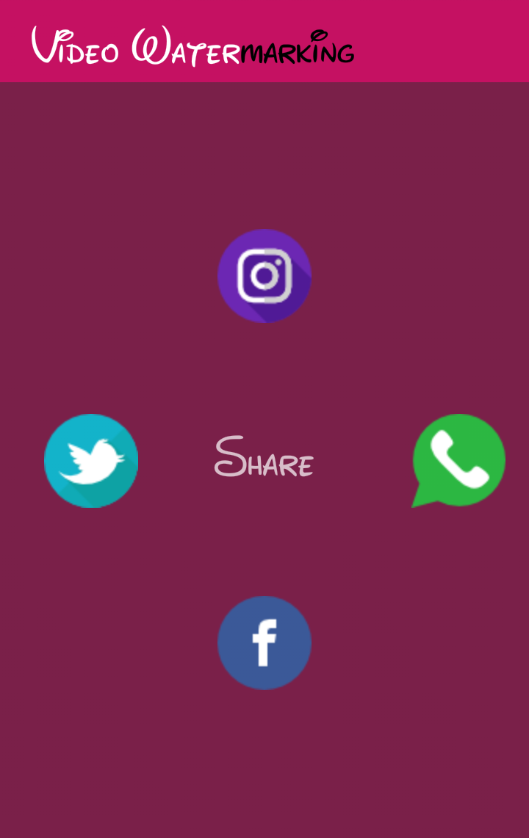
Demo with Snapshot
Preview of Module 7:
Publish your content on social media

Slide 18
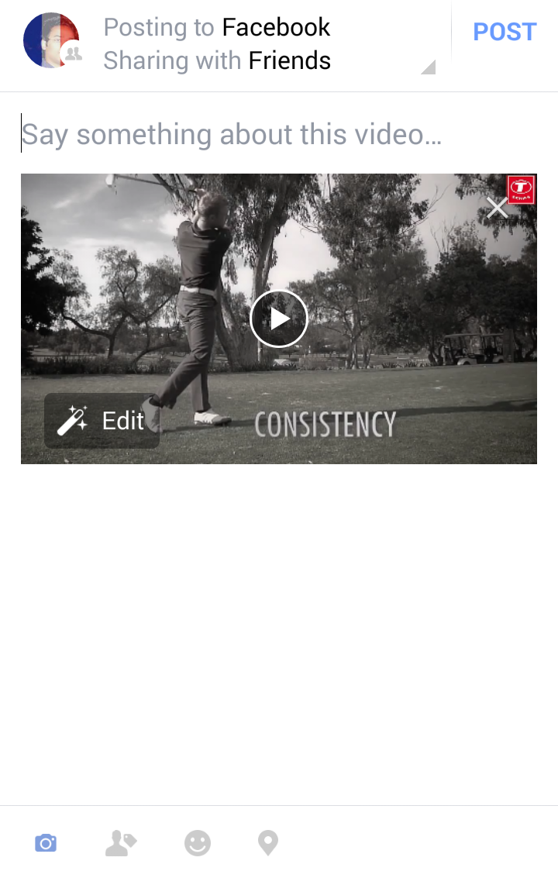
Demo with Snapshot
Preview of Sub Module 7.1:
Share with your friends on Facebook

Slide 19
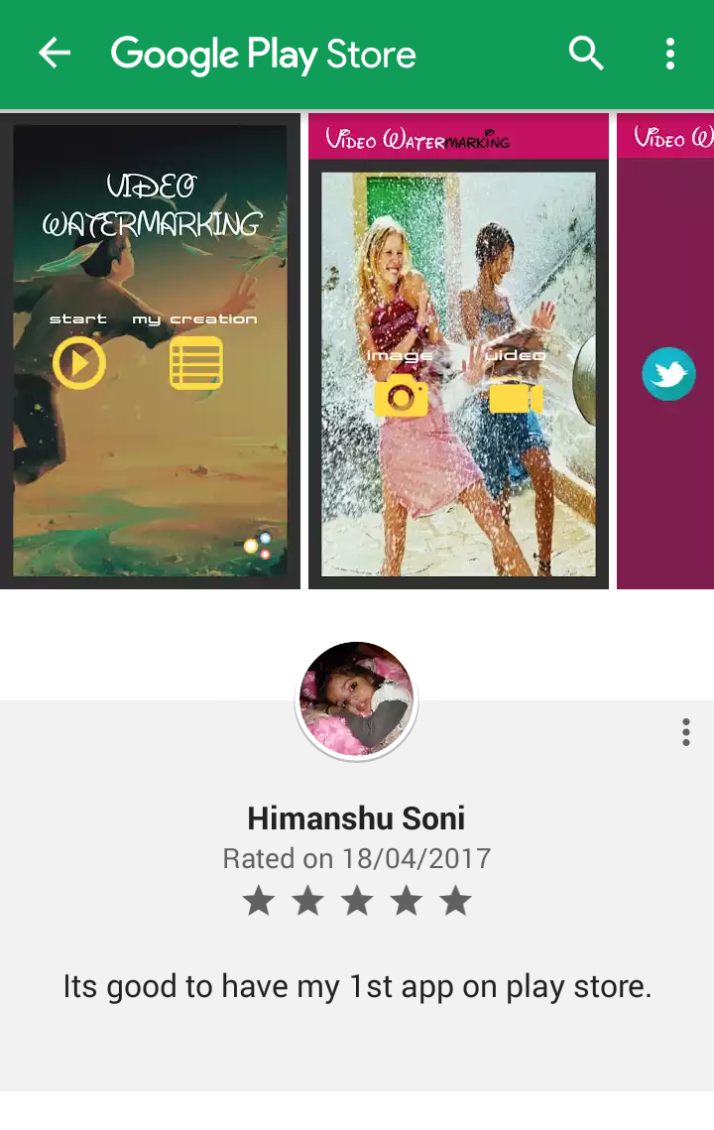
Demo with Snapshot
Preview of Sub Module 8:
Rate our app

Slide 20
Future Enhancement
Features | Present | Future
Platform | Android | iOS
API | API level 19(Kitkat) Android 4.4 and above | -
Text Watermarking | Not Present | Can be done
Filters on Video and Image | Limited like position | Can be enhanced like color, effect, border padding etc.
Processing or Transcoding Speed | Currently works on FFMPEG library and is slows | Some alternative and paid library can be used to enhance speed.

Slide 21
Sample Code
We have used above piece of code to:
-jump from one screen or activity to another.
-implement social networking features such as Whatsapp, Facebook, etc.
-open gallery in mobile.
-pic media content.
Intent intent =new Intent(<Current class>,<target class>);
startActivity(intent);

Slide 22
Implementation
FFMPEG:
FFmpeg is a free software project that produces libraries and programs for handling multimedia data.
FFmpeg includes:
1. libavcodec, an audio/video codec library used by several other
2. libavformat (Lavf), an audio/video container mux and demux library.
3. ffmpeg command line program for transcoding multimedia files.
FFmpeg is published under the GNU Lesser General Public License 2.1+ or GNU General Public License 2+.

Slide 23
Benefits of Using Our App
Publish your content: On social sites like Twitter, Facebook, Whatsapp.
Accessibility: Easily available on play store.
Cost: Free of cost(Unpaid app).

Slide 24
Project Limitation
The limitations of this app are:
.gif file format not supported.
.ico file format not supported.
Not supported on lower android api level.

Slide 25
Project Application and Conclusion
To protect ownership rights, mark this solution.
Provide security from attacks of your digital video contents.
Save and share your video on Facebook, WhatsApp, Instagram and Twitter.

Slide 26
References
http://www.vogella.com/tutorials/AndroidIntent/article.html
https://ffmpeg.org/ffmpeg-filters.html

